Slide 1
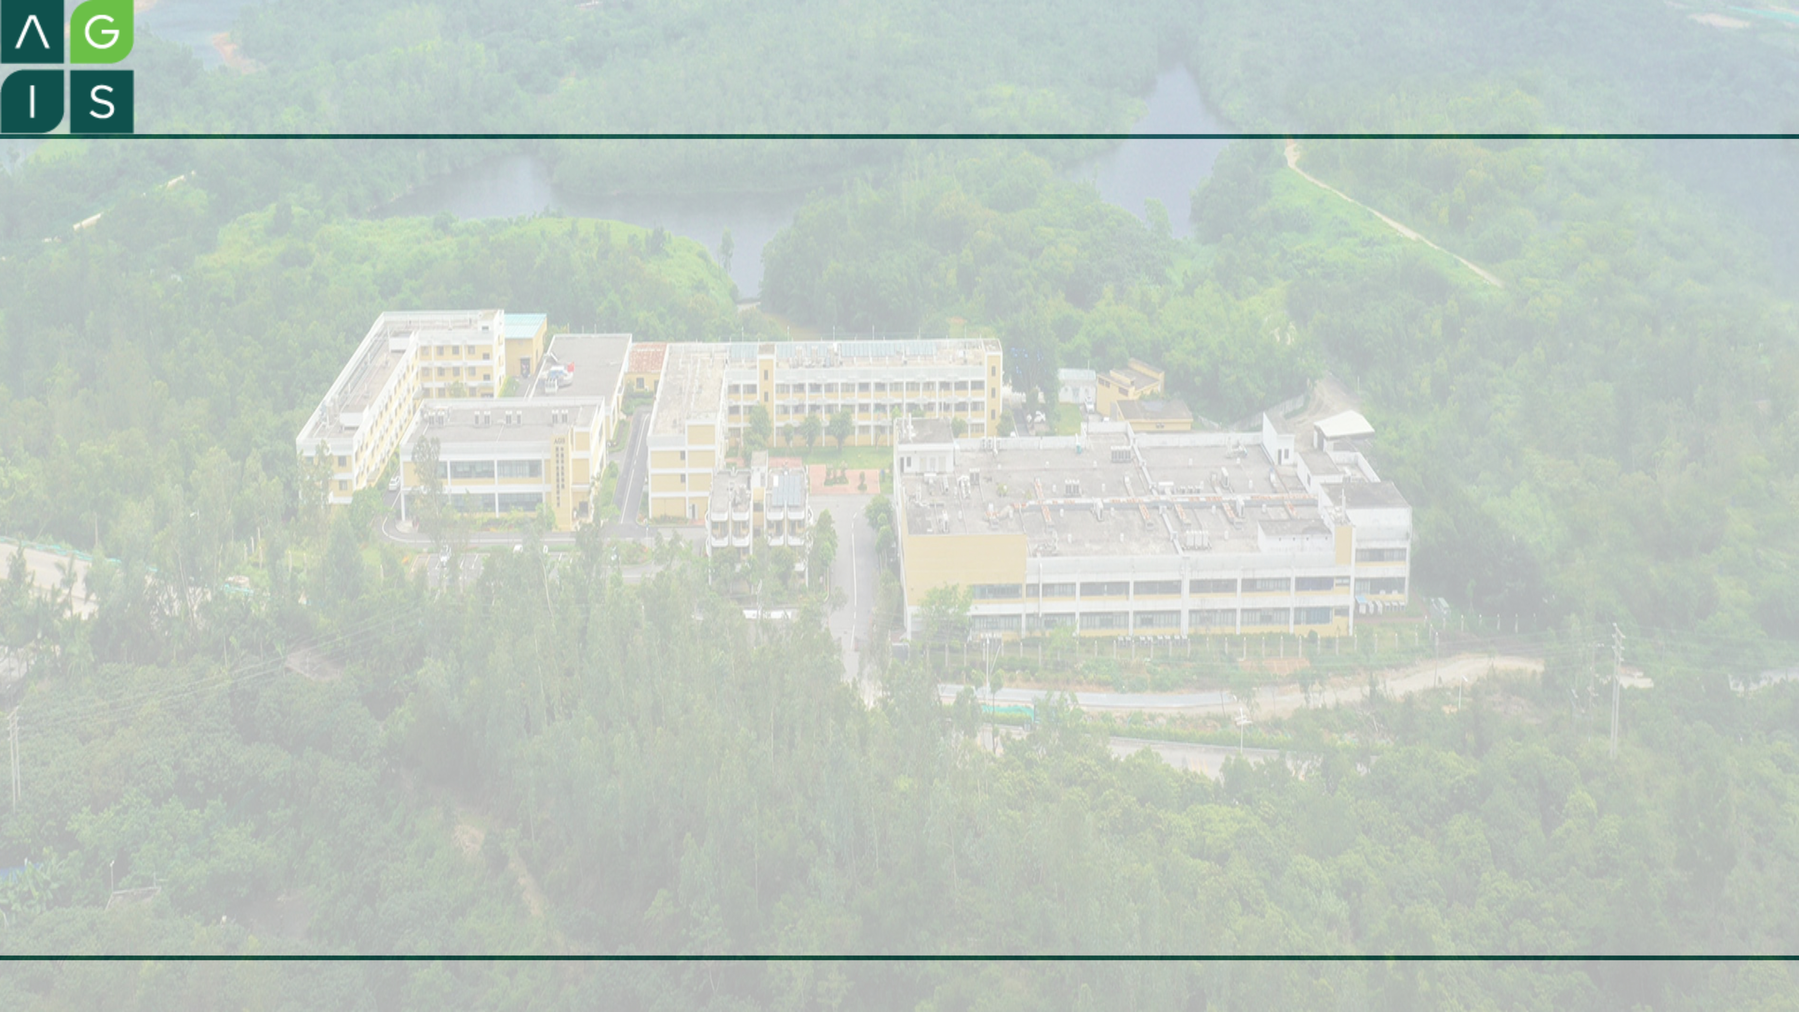
Connecting to Remote Server
Zou Yi
2021-9-22 18:30~7:15

Slide 2
Overview
Introduction
Windows Terminal
Windows Subsystem for Linux (WSL2)
Visual Studio Code
Other Softwares:
FileZilla
MobaXterm
Xterm

Slide 3
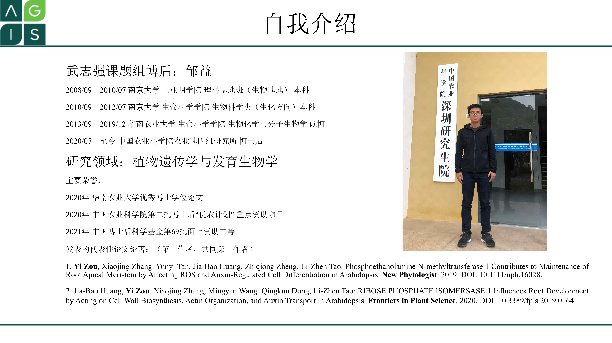

Slide 4
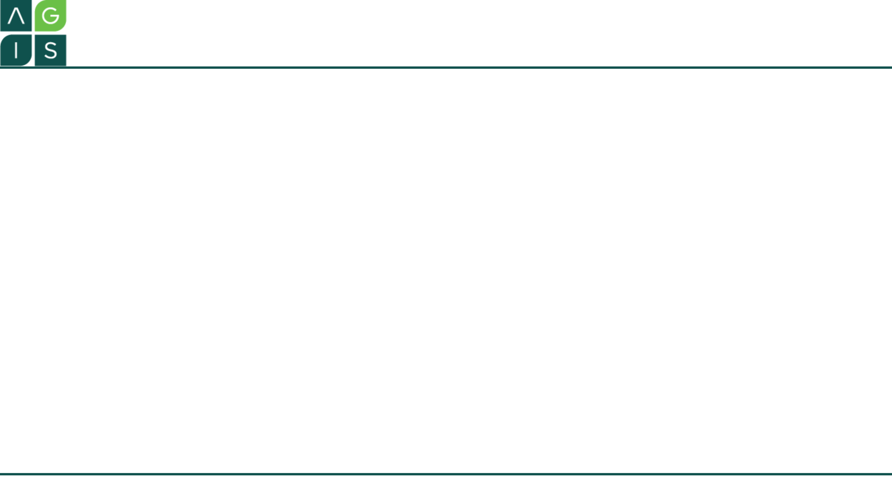
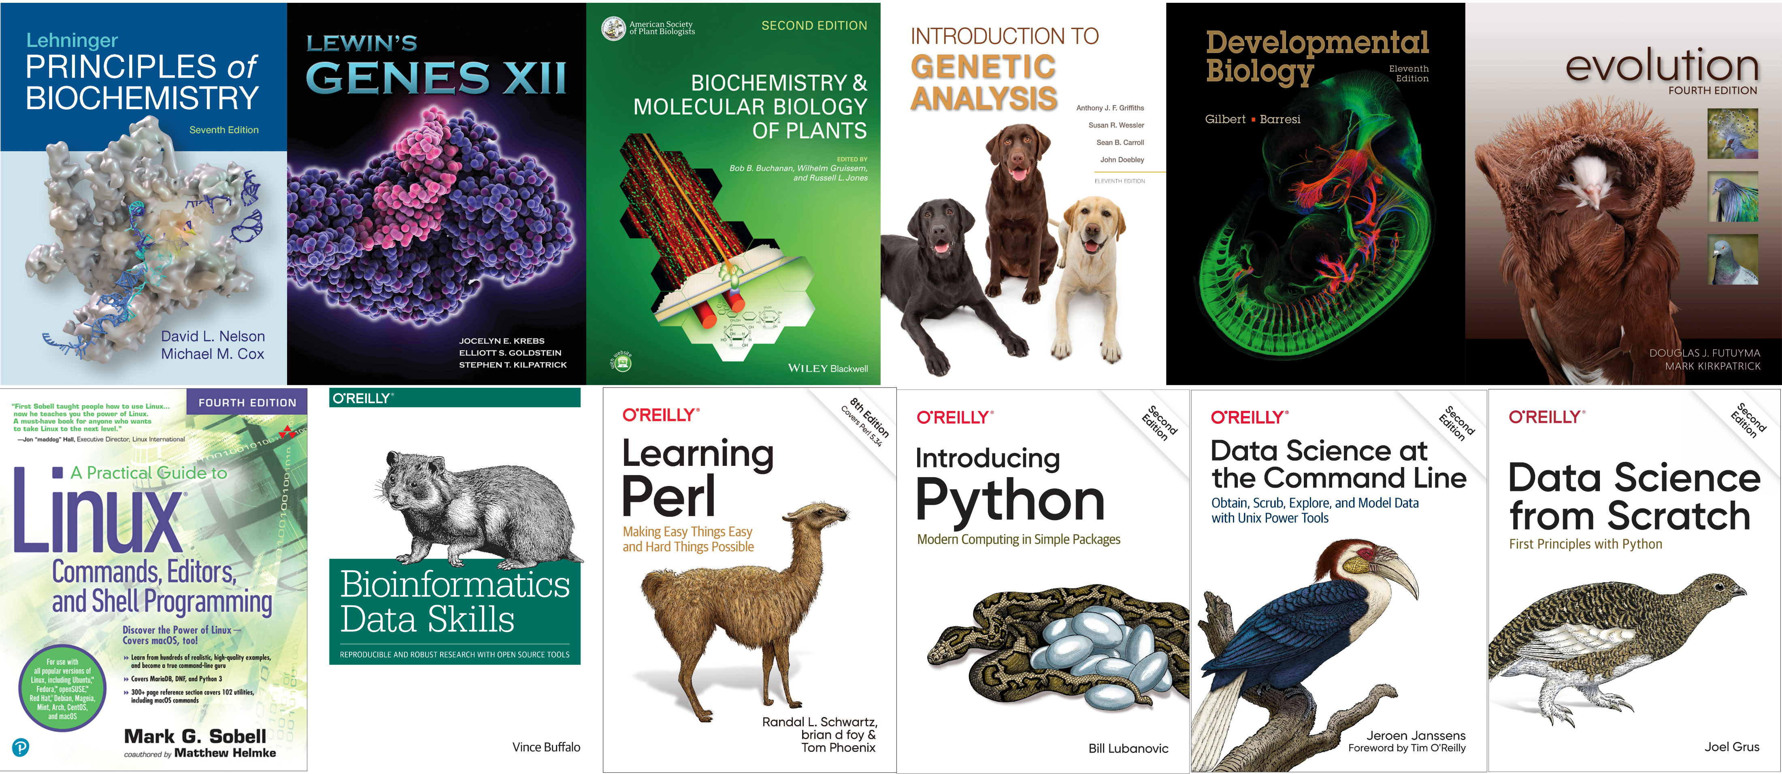
How to answer biological questions?
Modern biology is becoming Trinity of experimental biology, computer science and data analysis.

Slide 5
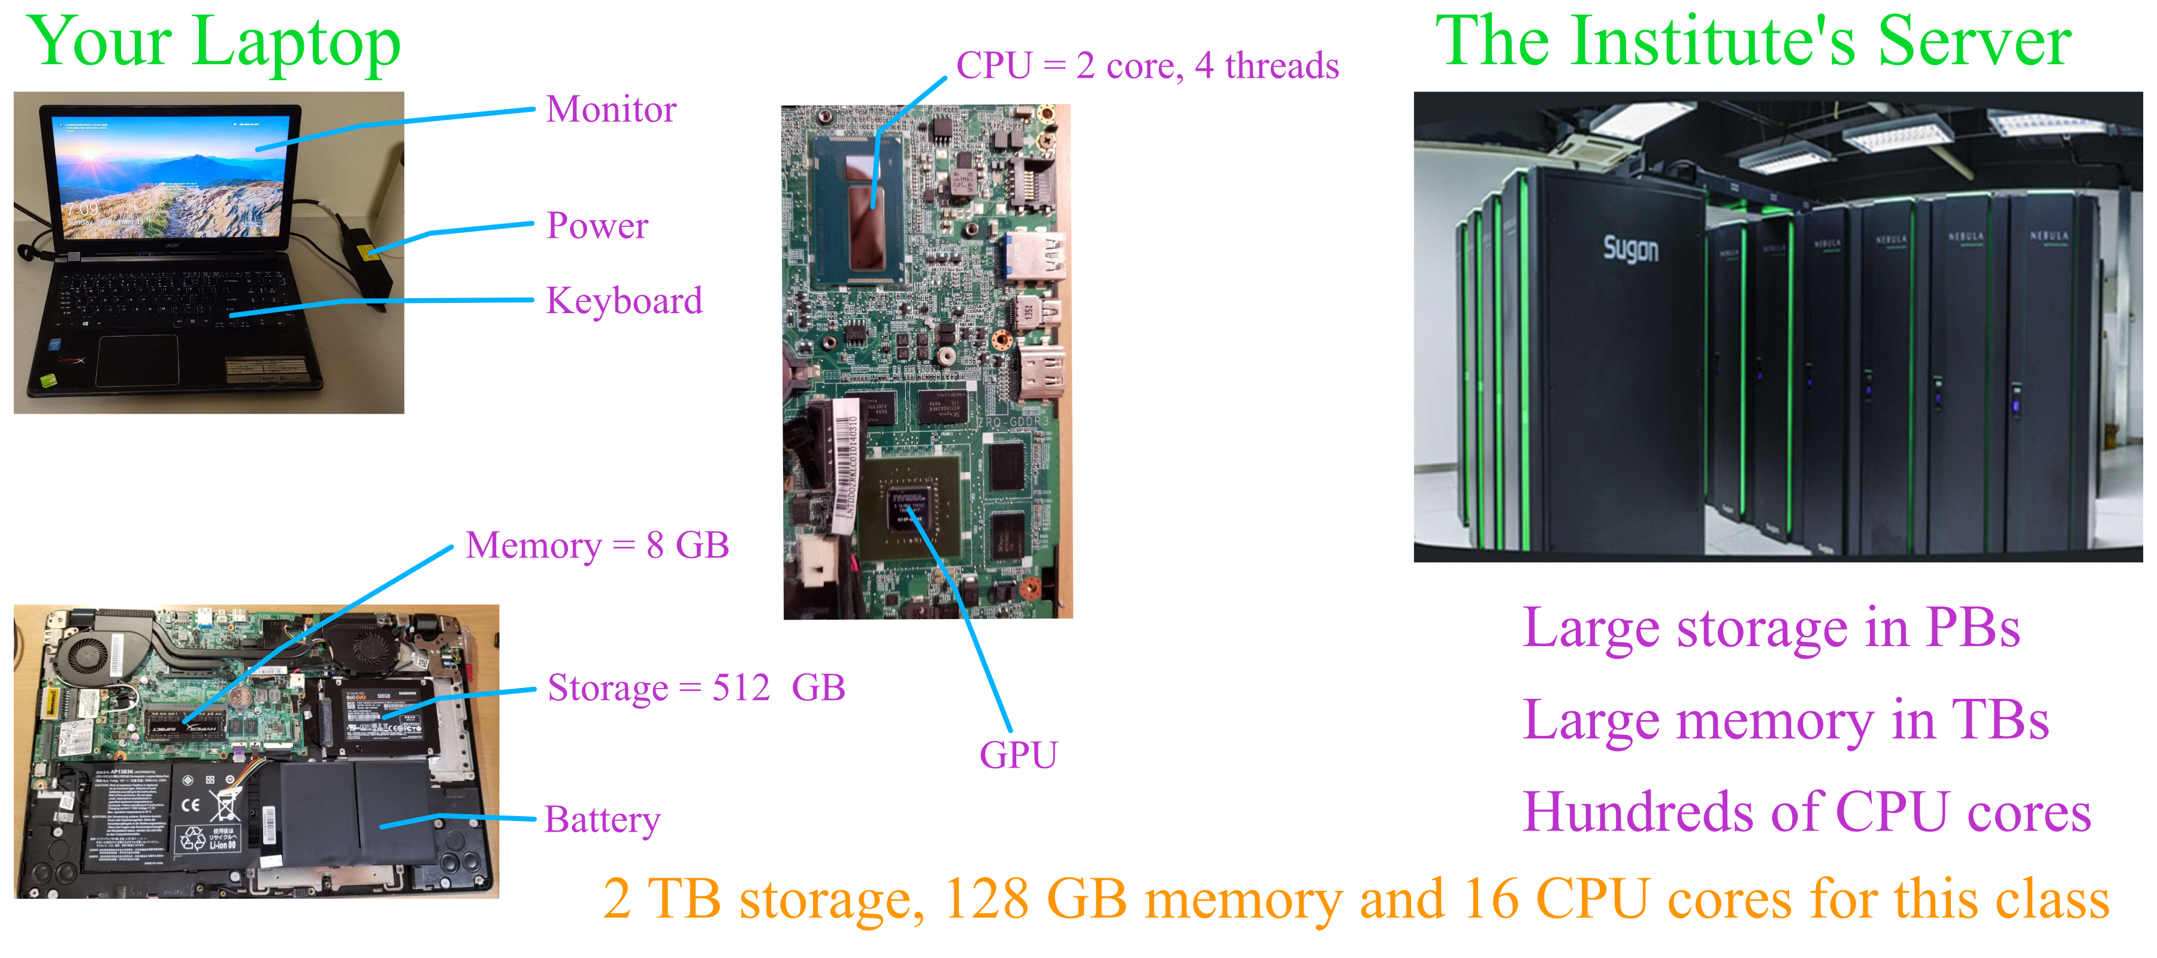
Why do we need the server?
Notes:
Methods in bioinformatics: scripts, programs, pipelines
Yours?

Slide 6
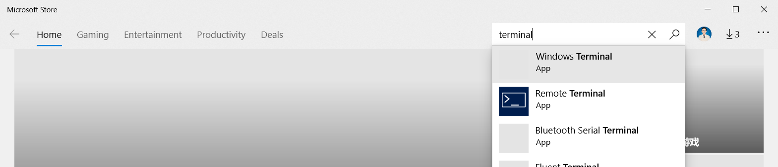
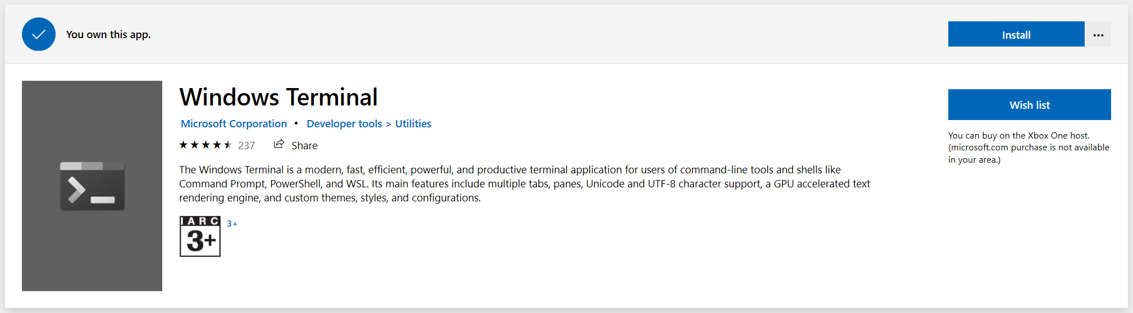
Install Windows Terminal
https://github.com/microsoft/terminal

Slide 7
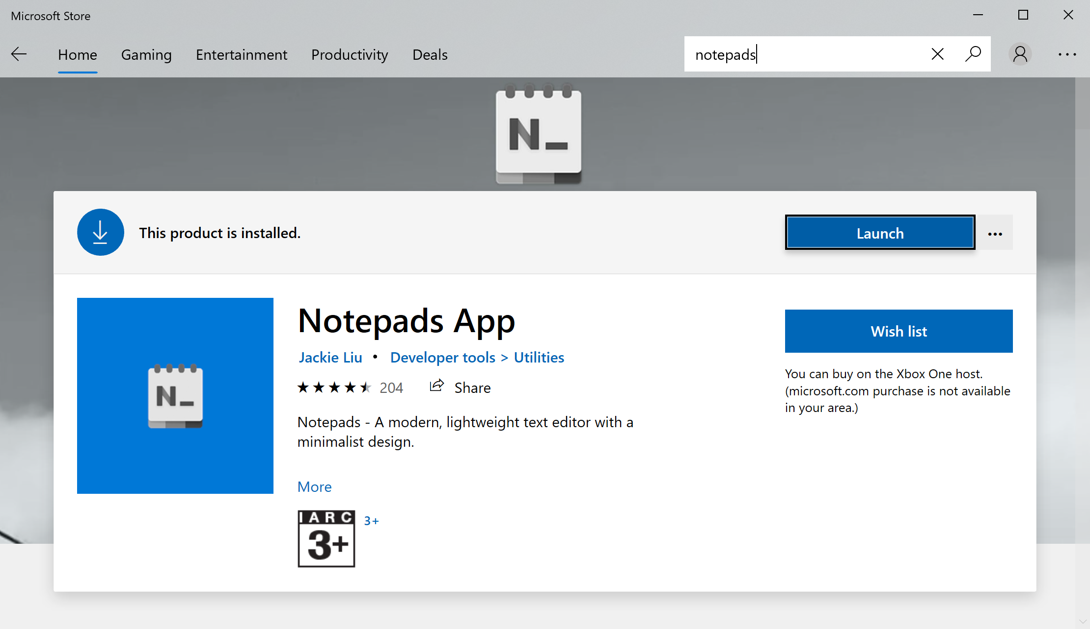
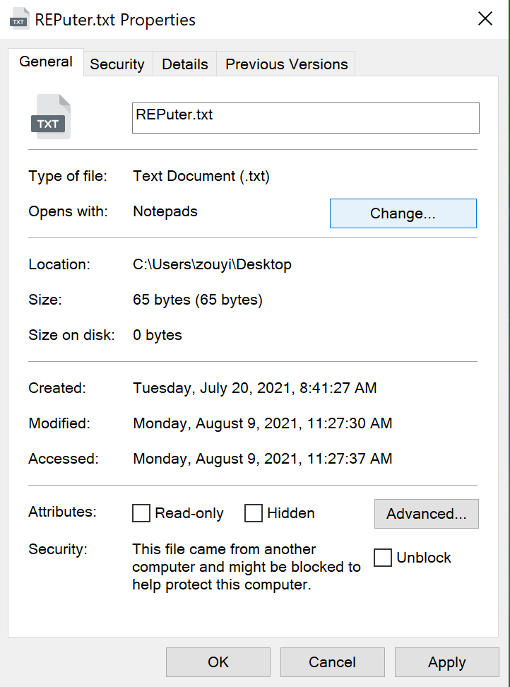
Install Notepads

Slide 8
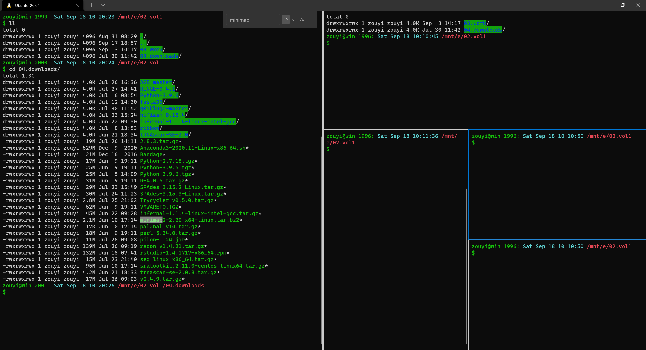
Command Palette of Windows Terminal
Ctrl + Shift + P
Ctrl + Shift + D
Alt + Shift + D
Alt + Shift + Minus
Alt + Shift + Equals
Alt + Shift + Arrow
Ctrl + Shift + F

Slide 9
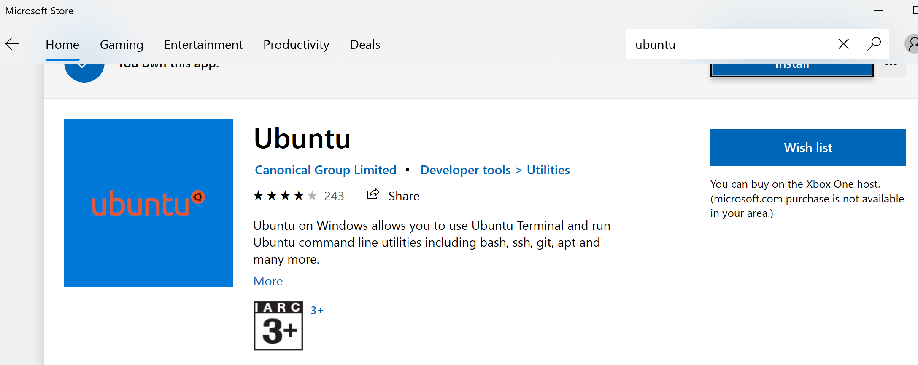
Windows Subsystem for Linux (WSL2)
WSL2 provides a fast, lightweight way to run Linux programs on Windows.
https://docs.microsoft.com/en-us/windows/wsl/install-win10
Step 1: Install WSL2
1) search for Turn Windows Features on or off
2) enable two features, the Virtual Machine Platform and the Windows Subsystem for Linux
3) reboot the computer
4) open Windows Terminal as an administrator
5) run the command: wsl --set-default-version 2
Step 2: Install Ubuntu
username: zouyi
password: zouyi
Step 3: updating the WSL2 Linux kernel
https://wslstorestorage.blob.core.windows.net/wslblob/wsl_update_x64.msi
Bidirectional access in Windows and Ubuntu
$ cd /mnt/c
$ explorer.exe .

Slide 10
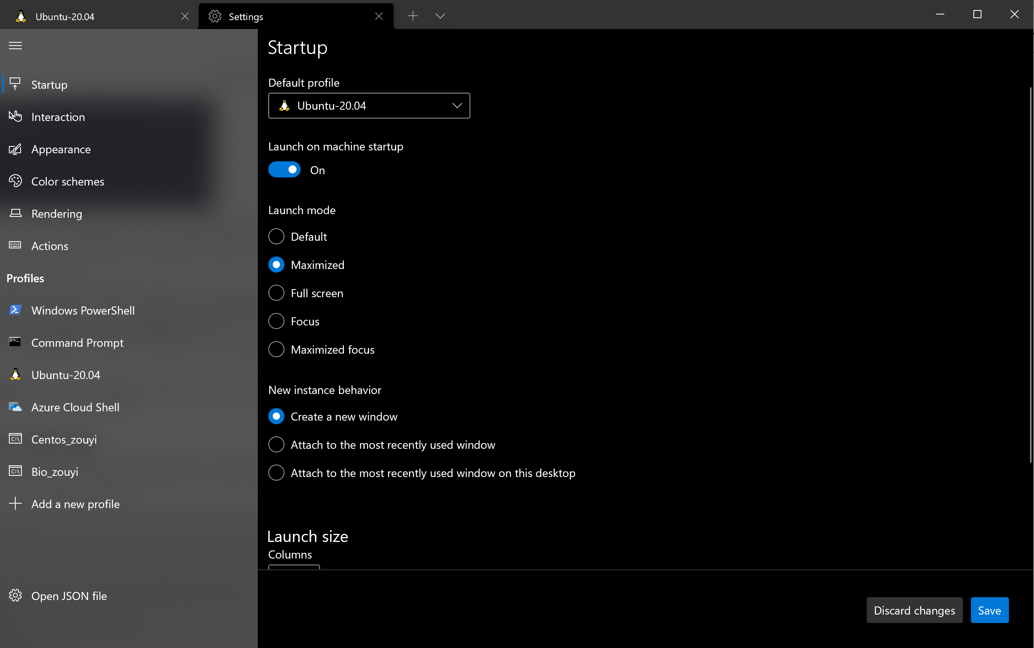
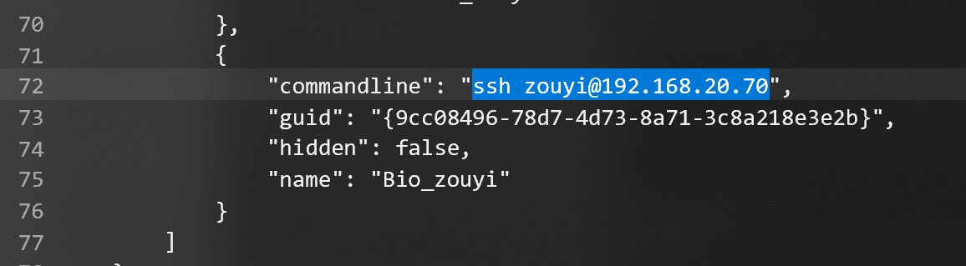
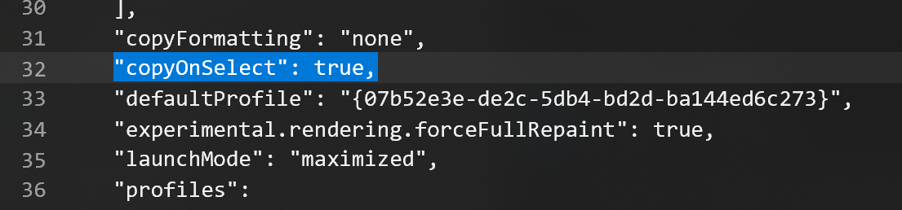
Adding Profiles for Secure Shell (SSH)
Settings: Open JSON file
Each profile object has a unique GUID (globally unique identifier)
Edit the JSON file
Save changes

Slide 11
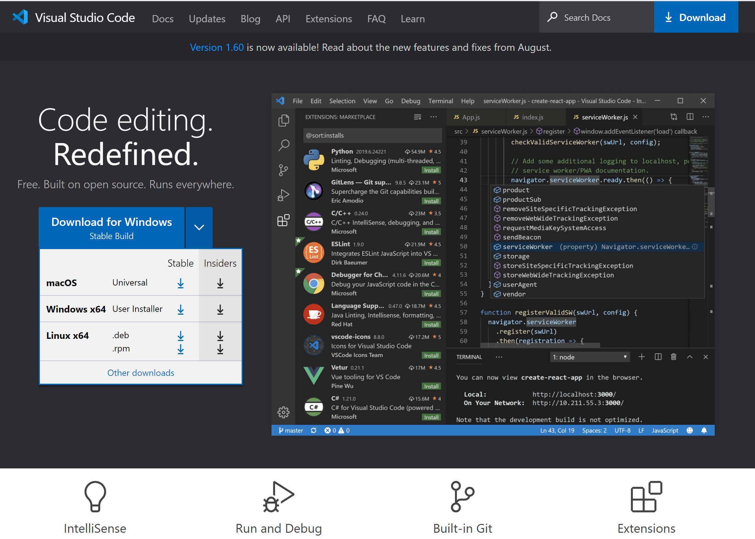
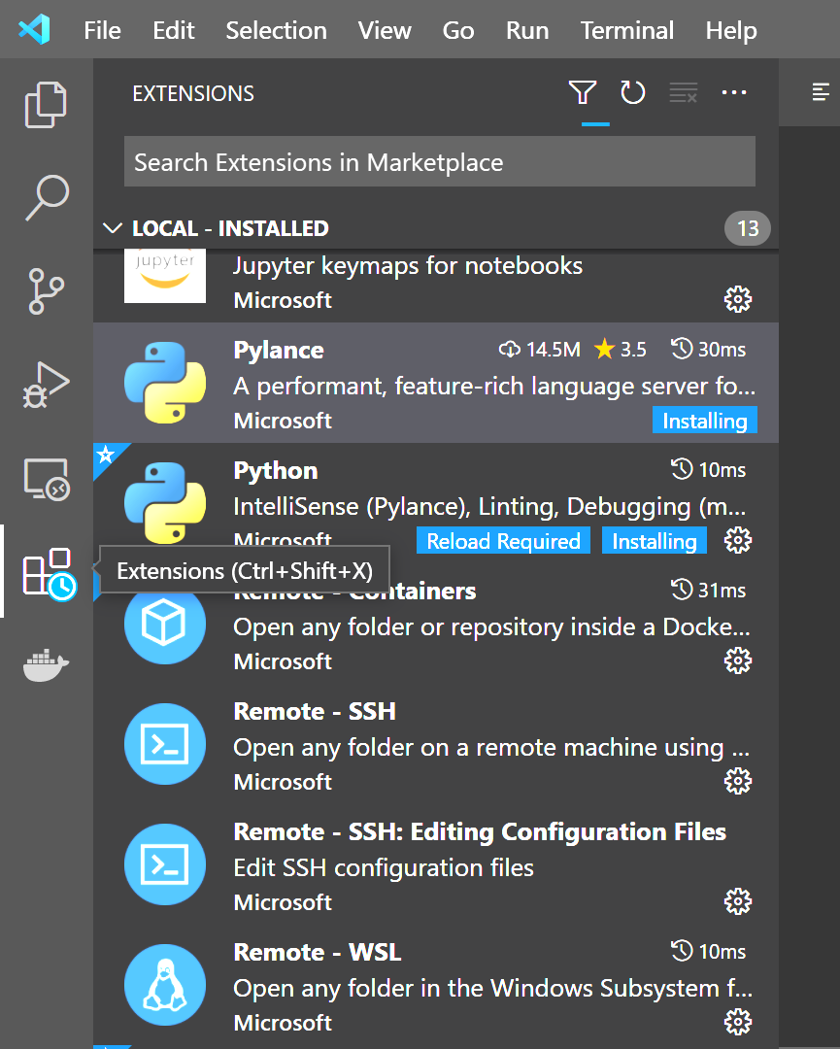
Install Visual Studio Code
Visual Studio Code is a free, cross-platform, open source code editor from Microsoft.
https://code.visualstudio.com/
Install extensions

Slide 12
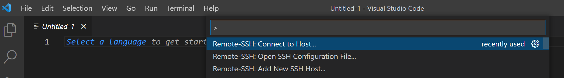
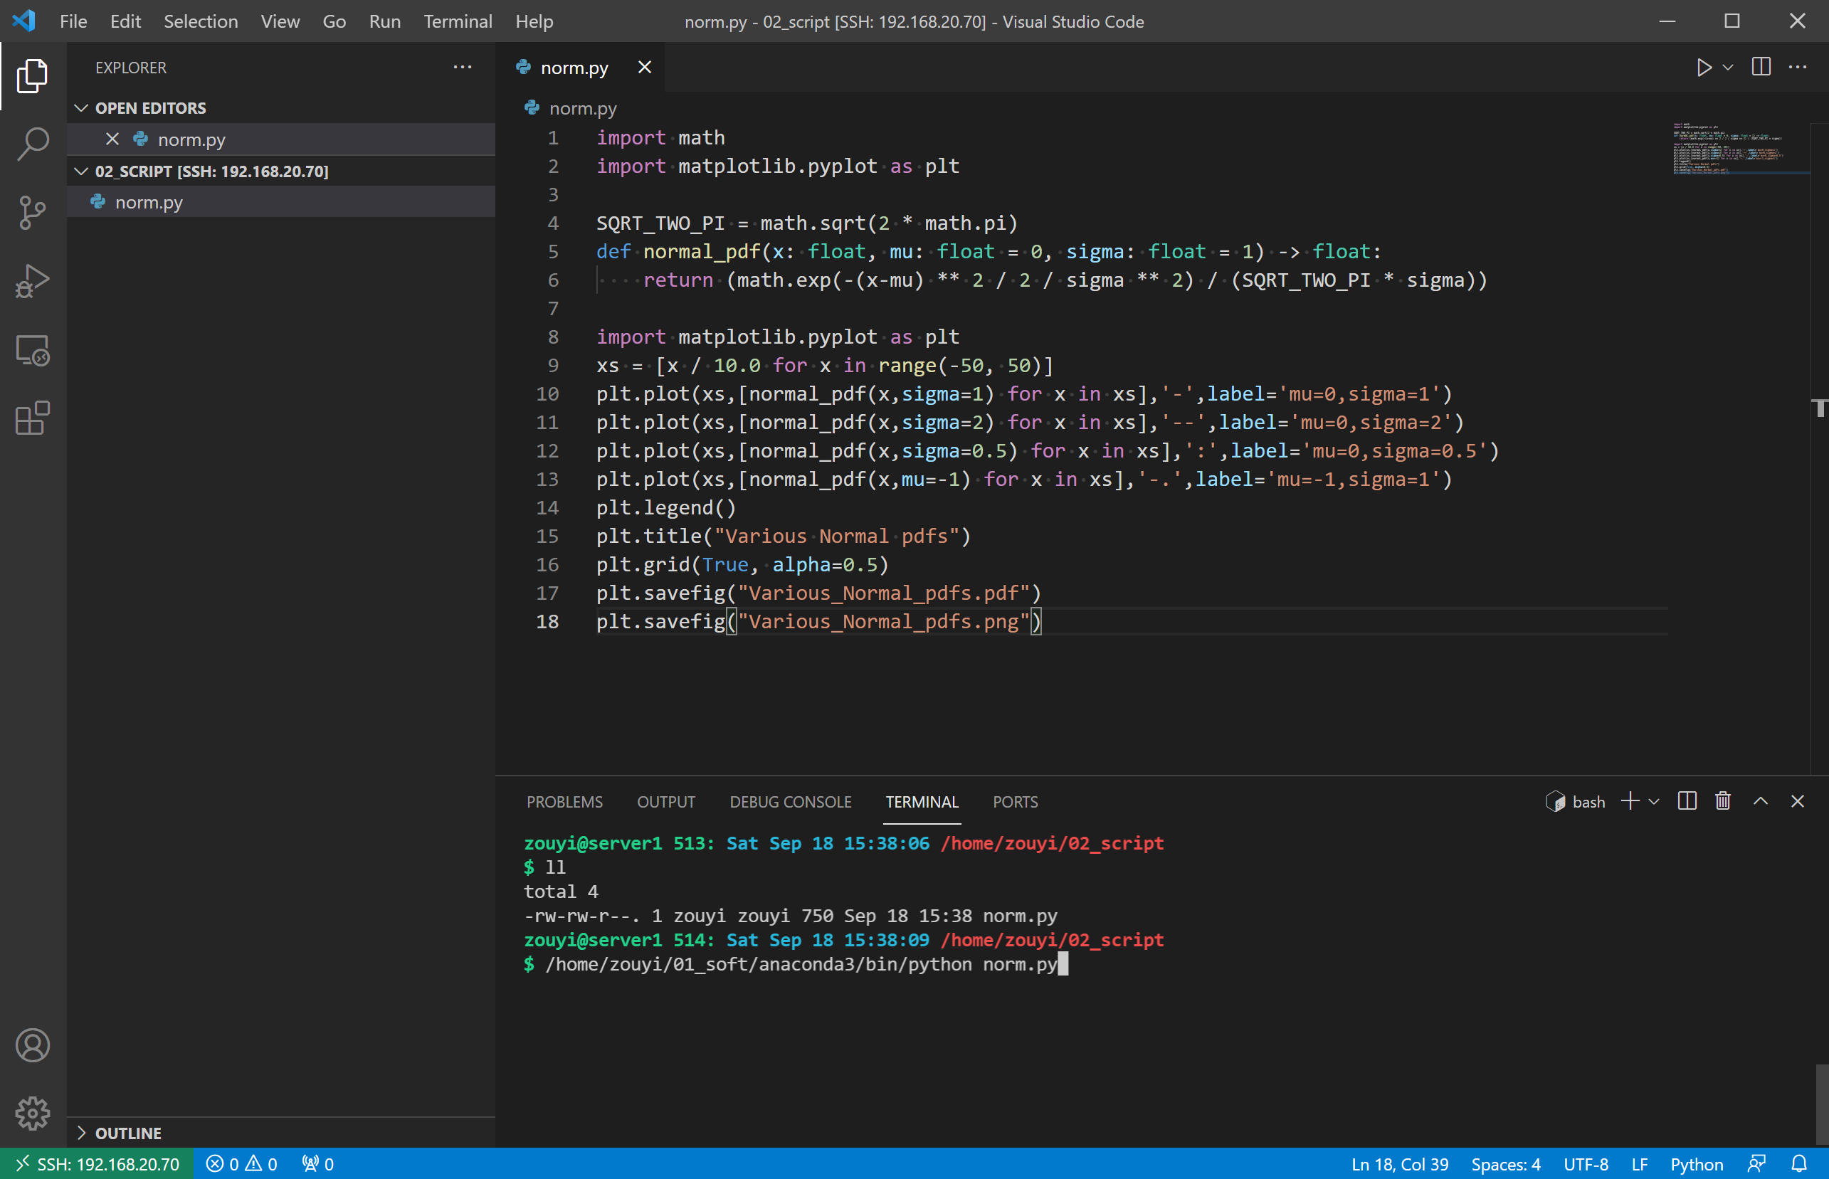
Visual Studio Code Remote
Press F1 button
Remote-SSH: Add New SSH Host…
ssh zouyi@192.168.20.70
Linux
Password: *****
Remote-SSH: Connect to Host…
192.168.20.70
code 02_script
code norm.py
$ python norm.py

Slide 13
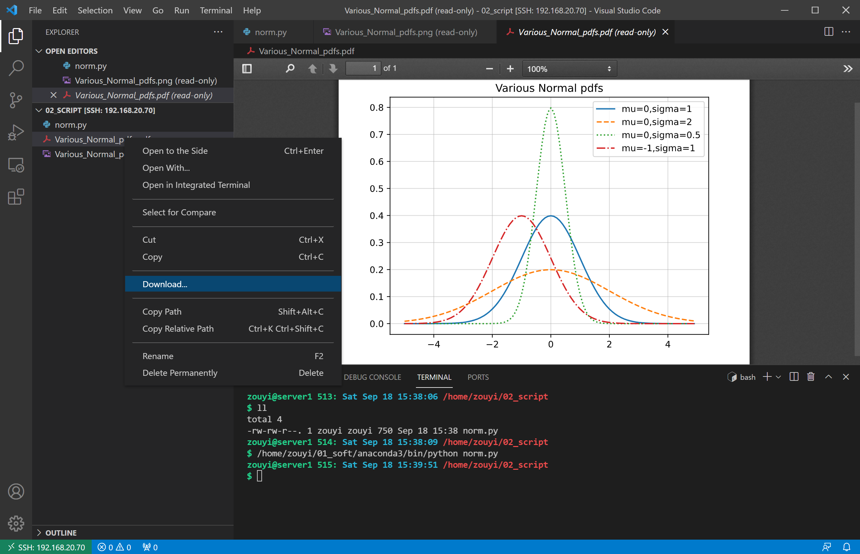
Check and download the result
Extension:
vscode-pdf

Slide 14
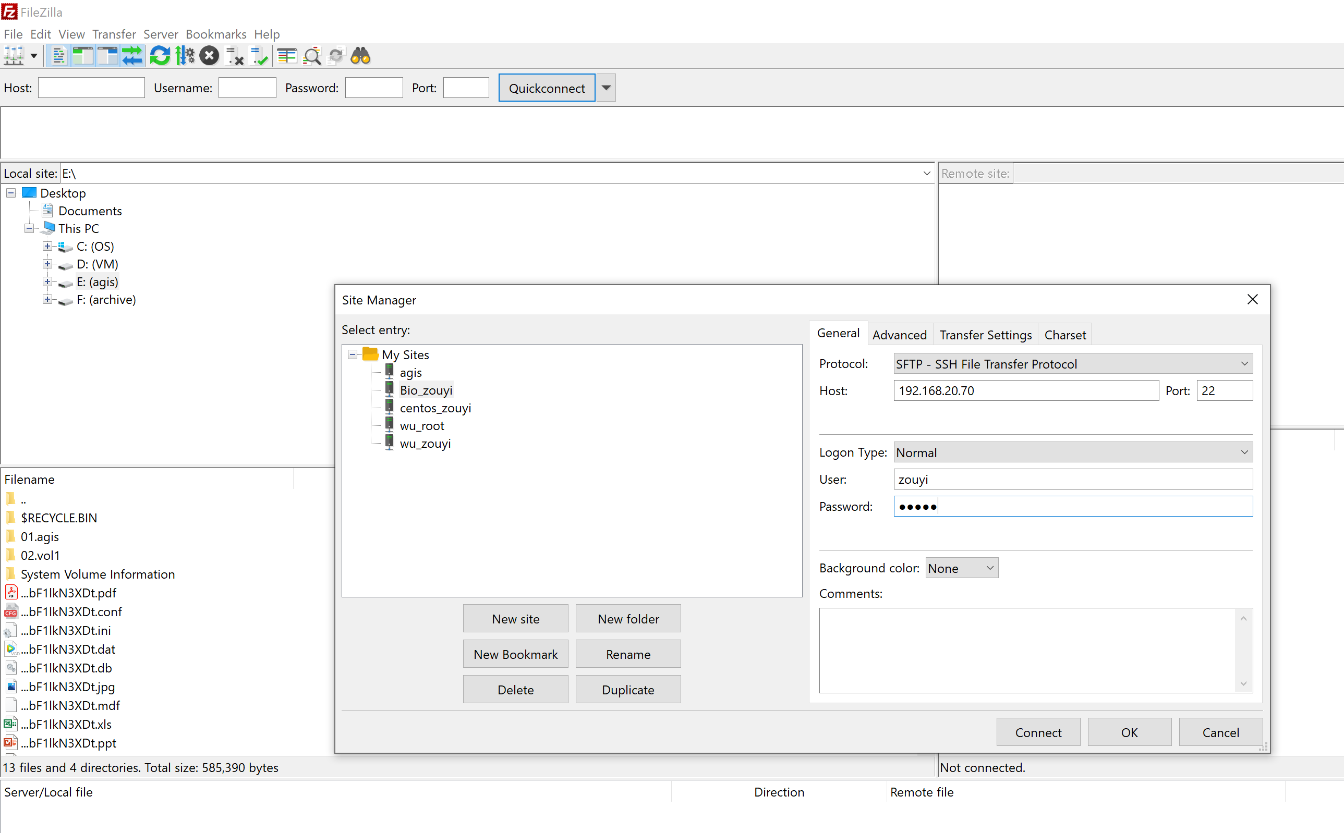
How to copy files to/from a remote server?

Slide 15
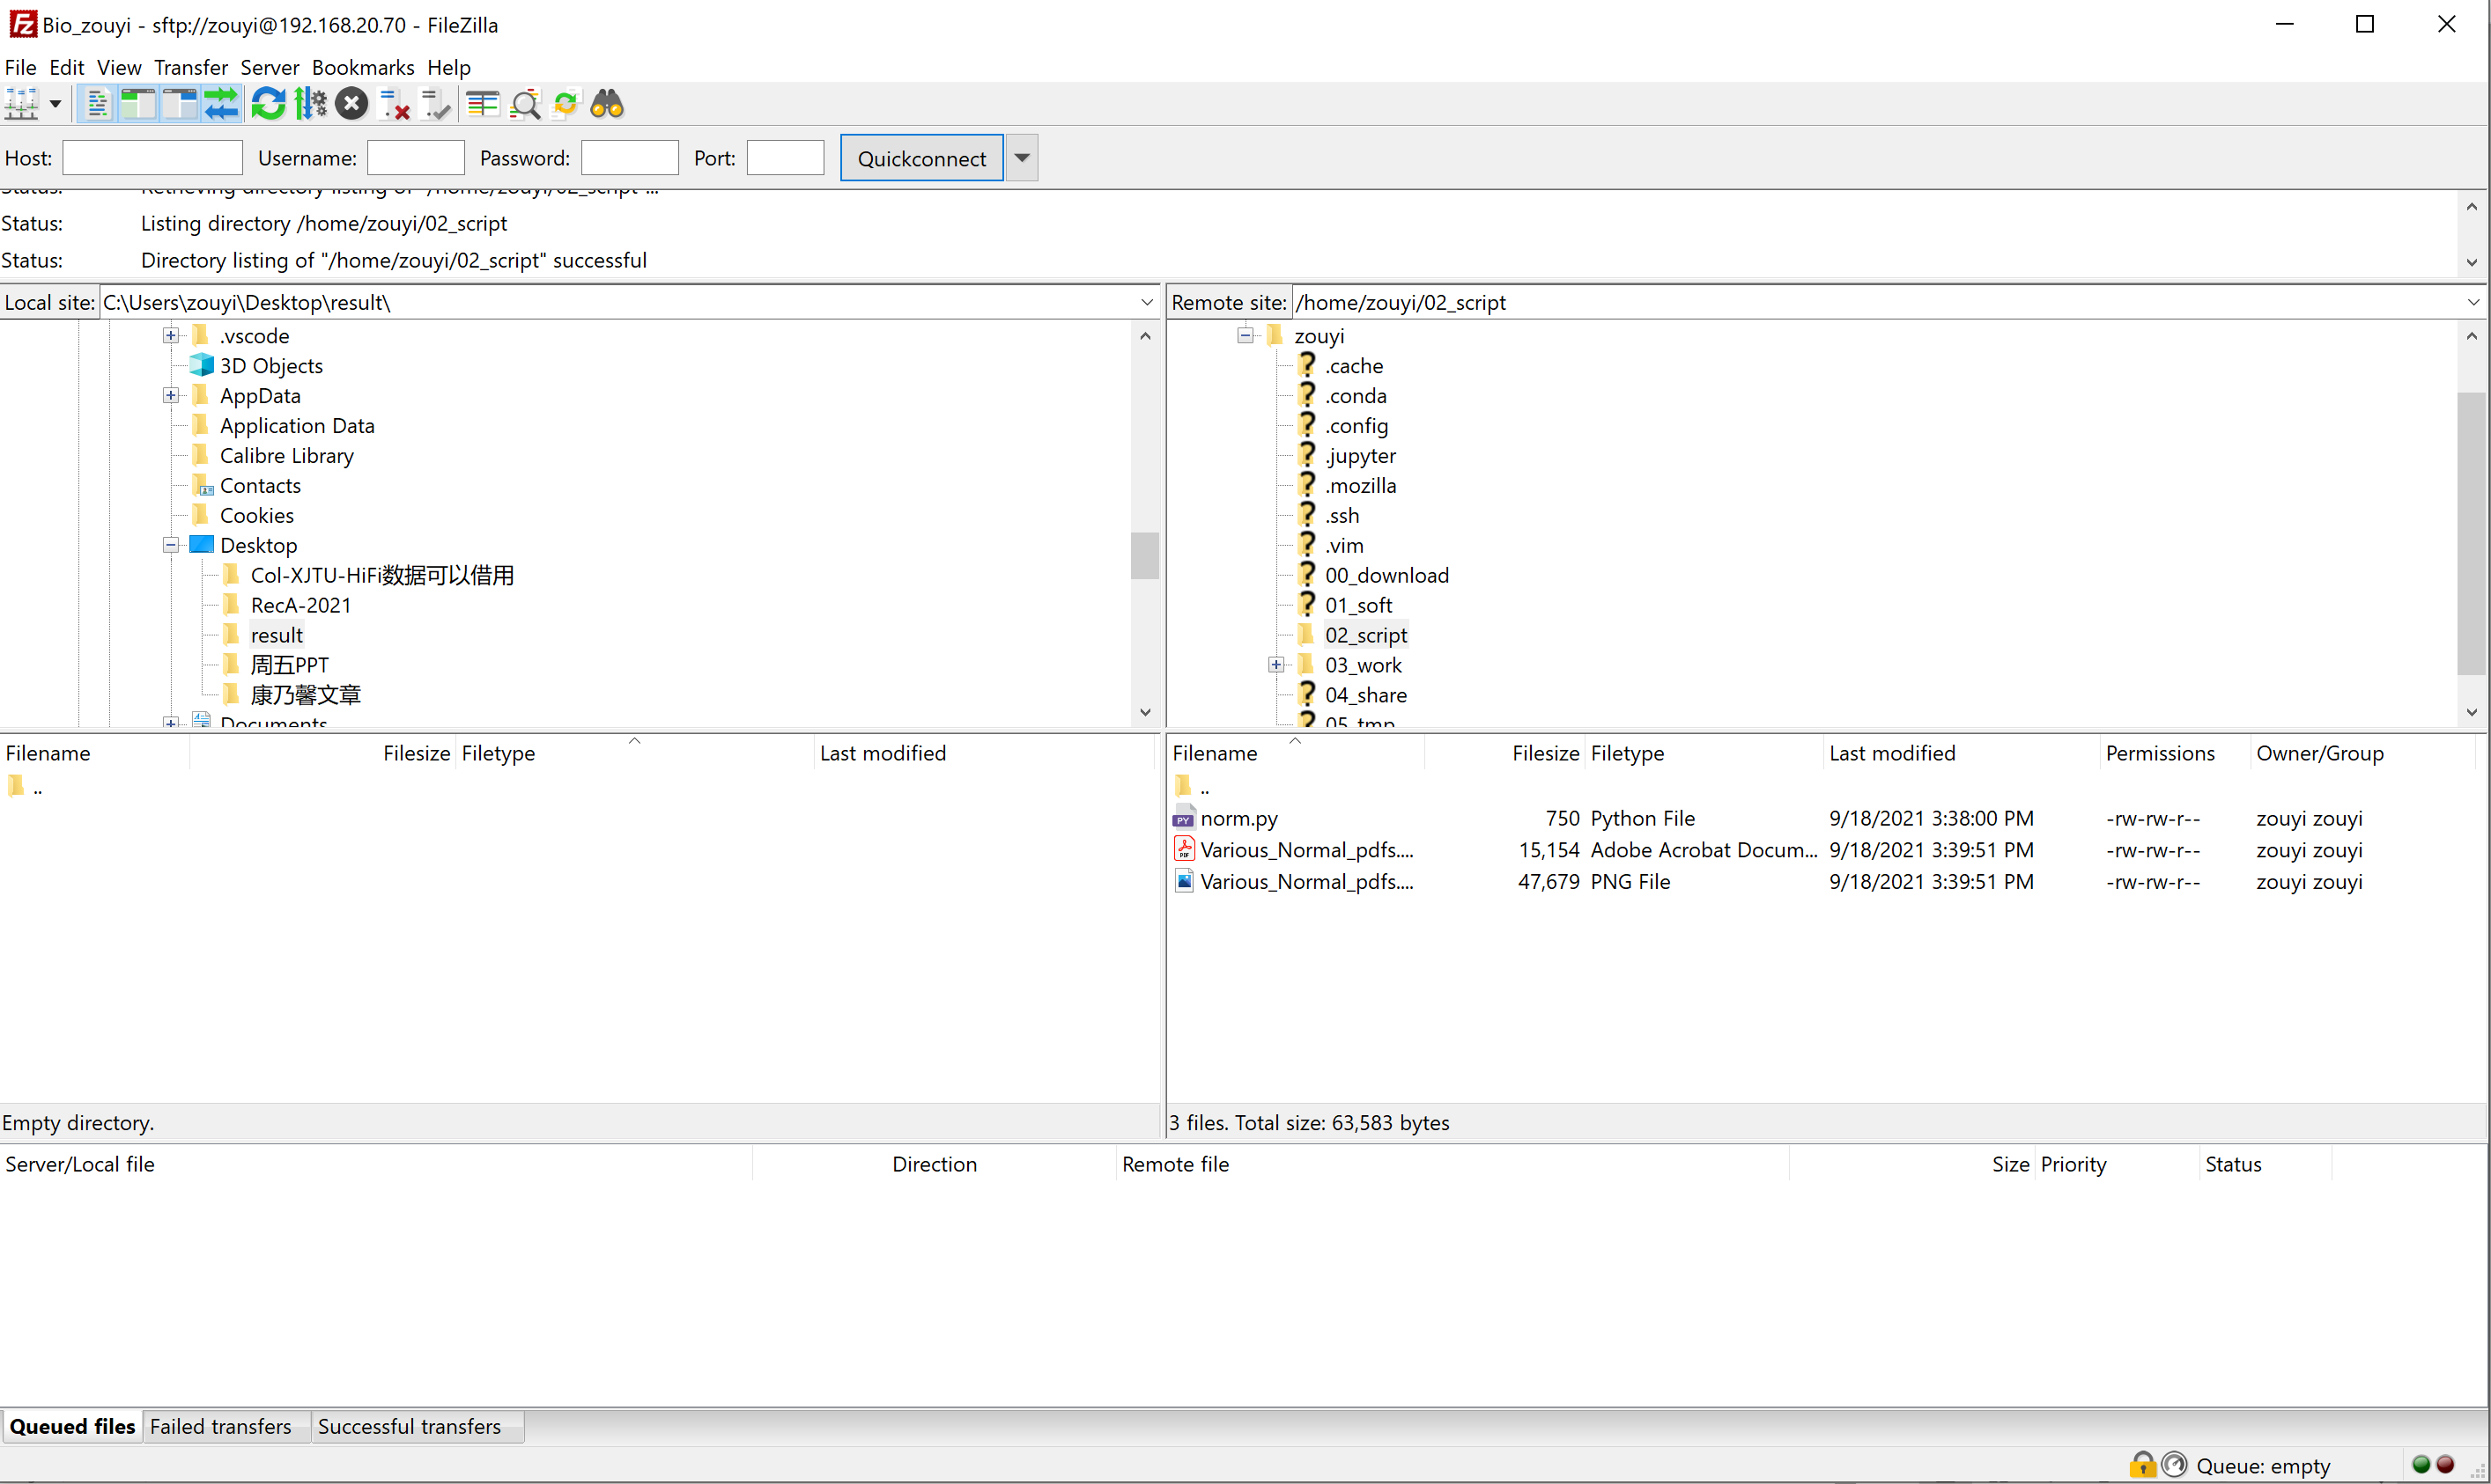
How to copy files to/from a remote server?

Slide 16
Thanks!

